Slide 1
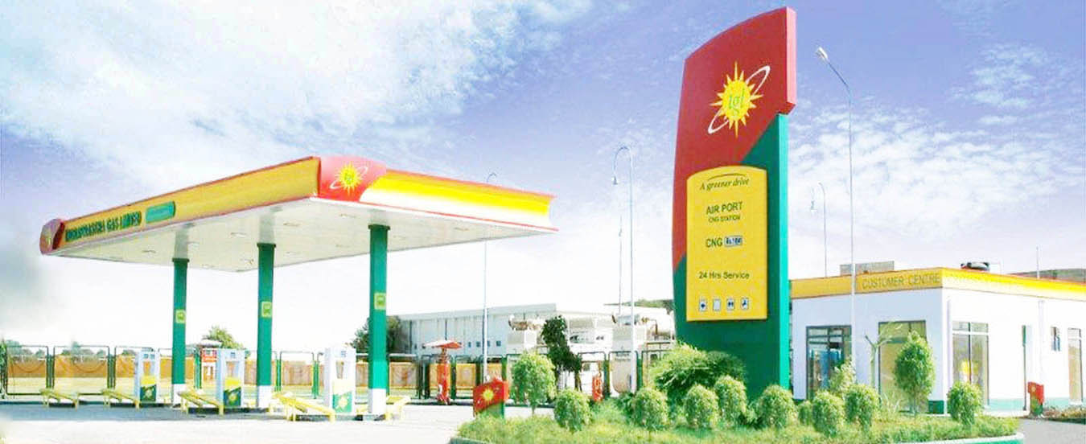

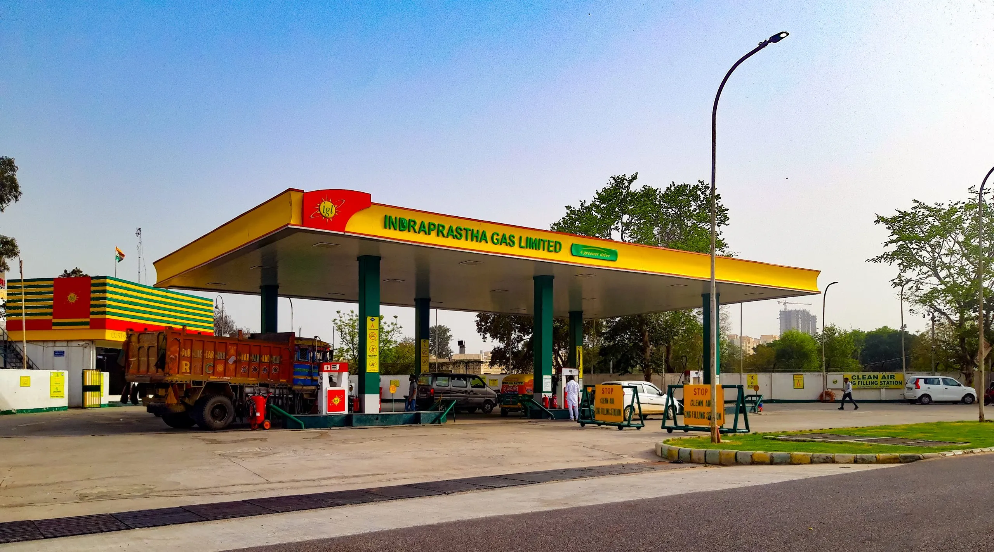
Indraprastha Gas Limited
An Overview
April 2025

Slide 2

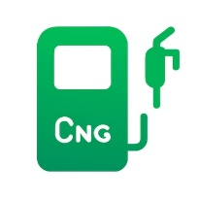
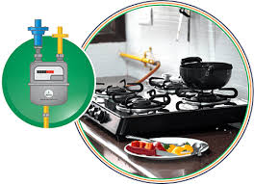



Background
Incorporated in 1998, IGL is a Joint Venture of GAIL and BPCL. Govt. of NCT of Delhi is also holding 5% equity
The company was listed in stock exchange in December 2003.
IGL started its operations in NCT of Delhi in 1999 with only 9 CNG stations and 1000 PNG consumers.
Where we operate
NCT of Delhi
Noida
Greater Noida
Ghaziabad & Hapur
Gurugram
Faridabad
Rewari
Karnal
Kaithal
Kanpur, Hamirpur, Fatehpur
Muzaffarnagar, Meerut, Shamli
Ajmer Pali Rajsamand
Banda, Chitrakoot Mahoba
954 CNG Stations
31 Lacs Domestic Connections
~12,000 I&C Connections
Fueling the largest CNG Bus fleet in the World

Slide 3
Shareholding Pattern As on 31 March 2025

Slide 4

Management
IGL Board is fairly well diversified with ten members including two each from GAIL and BPCL, one from Govt. of Delhi and five independent directors.
The company is beneficiary of its strong parentage and gets significant support from GAIL and BPCL relating to operations and management.
By virtue of the presence of Govt. of Delhi as a minority shareholder, the company gets support for speedy administrative approvals.
The company has highly qualified senior management personnel with several years of experience in Oil & Gas sector.

Slide 5
Areas of Operation
Delhi: National capital of India has huge demand potential:
  Where public transport vehicles have to necessarily run on CNG in view of the directions of the Hon. Supreme Court of India. However in recent times the government is promoting EV.
  Has the highest number of private cars compared to any other city of India.
  Thickly populated having large number of residential & commercial complexes and hospitals etc.
Gautam Budh Nagar (Noida & Greater Noida): Most advanced cities of state of Uttar Pradesh having huge potential for CNG, PNG-Residential and commercial volumes.
Ghaziabad: Residential cum Industrial town of Uttar Pradesh having huge potential demand for PNG Residential, Commercial and Industrial. PNGRB has recently clarified that the GA of Ghaziabad includes Ghaziabad and Hapur Districts.
Rewari, Dharuhera & Bawal: IGL was authorized for Rewari geographical area in the 6th round of bidding by PNGRB. IGL has commissioned forty eight CNG stations in the GA and started sale of PNG to Domestic households. Bawal being an Industrial town of Haryana having huge potential demand for Industrial PNG.
Karnal: IGL was authorized for Karnal geographical area in the 8th round of bidding by PNGRB. IGL has commissioned thirty CNG stations in Karnal GA. CNG & PNG sale has started.

Slide 6
Areas of Operation
Meerut, Muzaffarnagar & Shamli: IGL has been authorized for Meerut (Except area already authorized), Muzaffarnagar & Shamli geographical area in the 9th round of bidding by PNGRB in which IGL has commissioned forty four CNG stations and started sale of PNG to Domestic households and commercial customers.
Gurugram: IGL is also laying infrastructure in Gurugram. The permission has been given for the area between west side of Sohna Road and NH 8 in Gurugram district. IGL has commissioned twenty seven CNG stations in the GA. Dispute regarding license to operate in the entire Gurugram is subjudice.
Kaithal; Kanpur, Fatehpur & Hamirpur; and Ajmer, Pali & Rajsamand: IGL has been authorized for Kaithal; Kanpur (Except area already authorized), Fatehpur & Hamirpur; and Ajmer, Pali & Rajsamand areas in the 10th round of bidding by PNGRB. IGL has commissioned fifteen, twenty five and eighty one CNG stations in three GAs respectively. PNG Domestic sale has started in Kanpur; Ajmer & Pali.
Banda, Chitrakoot & Mahoba: IGL has been authorized for Banda, Chitrakoot & Mahoba in the 11th round of bidding by PNGRB. IGL has commissioned thirty one CNG station in GA. Sale of PNG to Domestic household also started.

Slide 7
Current Sales Volume Mix (%)
Total Sales – 8.99 mmSCMD
Delhi: 5.38 mmSCMD
UP: 2.27 mmSCMD
Haryana: 0.73 mmSCMD
Rajasthan: 0.10 mmSCMD
NG: 0.50 mmSCMD

Slide 8
Yearly Sales Volume Segment wise (mmSCM)

Slide 9

Gas Sourcing
Allocation from Govt. of India of domestic gas for CNG and PNG Domestic segment.
Lower prices of domestic gas makes the economics of switching to gas more attractive driving growth in CNG & PNG- Domestic segments which constitute around 82% of the total sales volumes.
During Q4 of FY 24-25 the domestic gas allocation stood at 50% for priority segment.
Have tied up long term/ mid term contract for RLNG/HPHT to meet PNG Industrial & Commercial demand and shortfall in Domestic Gas allocation for CNG & DPNG.
Buying short term gas from the open market through tendering and IGX on need basis.

Slide 10
Current Gas Mix (%) (Overall Purchases)

Slide 11
Growth in CNG Segment

Slide 12
CNG Station Network
Station | IGL | DTC/ UPSRTC | OMC | DODO | Total
Online | 183 | 64 | 464 | 81 | 792
Daughter Booster | 0 | 0 | 105 | 5 | 110
Daughter | 0 | 0 | 51 | 0 | 51
LNG | 1 | 0 | 0 | 0 | 1
Total | 184 | 64 | 620 | 86 | 954

Slide 13
CNG Station Network
Station | IGL | DTC/ UPSRTC | OMC | DODO | Total
Online | 183 | 64 | 464 | 81 | 792
Daughter Booster | 0 | 0 | 105 | 5 | 110
Daughter | 0 | 0 | 51 | 0 | 51
LNG | 1 | 0 | 0 | 0 | 1
Total | 184 | 64 | 620 | 86 | 954

Slide 14
CNG Vehicles (Figures in Nos.) IGL GA’s
*Re casted Estimated figures based on various sources. Does not exclude vehicles phase out, if any.

Slide 15
PNG Connections

Slide 16
PNG Network (Figures in kilometers)

Slide 17
Cumulative Capex (Rs. in Crores)

Slide 18
Standalone Financial Data (Rs./ Crores)

Slide 19
Dividend
Dividend Policy provides liberal payout
Track record of last five years
Year | % of face value of share | Rs/Share
FY 18-19 | 120 | 2.40
FY 19-20 | 140 | 2.80
FY 20-21 | 180 | 3.60
FY 21-22 | 275 | 5.50
FY 22-23 | 650 | 13.00
FY 23-24 (interim) | 200 | 4.00
FY 23-24 (Final) | 250 | 5.00
FY 24-25 (Interim) | 275 | 5.50

Slide 20
Equity in Other CGDs and results
IGL has acquired 50% equity share capital of Central UP Gas Limited (CUGL) at a price of Rs. 23 per equity share aggregating to Rs.68 crores.
CUGL is engaged in the CGD business in the cities of Kanpur and Bareilly, Unnao & Jhansi in Uttar Pradesh.
IGL has acquired 50% equity share capital of Maharashtra Natural Gas Limited (MNGL) at a price of Rs.38 per equity share aggregating to Rs.190 crores.
MNGL is engaged in the CGD business in the city of Pune, Pimpri-Chinchwad, Talegaon, Chakan and Hinjewadi.
The standalone and consolidated financial results for the year ending March 25 with the Associates i.e. CUGL & MNGL on equity method considering 50% share in profit are as under:
Parameter | Unit | Standalone | Consolidated
Total Comprehensive Income | Rs. in Crores | 1467 | 1713
EPS | Rs./Share | 20.96 | 24.47

Slide 21
Future Outlook
Approximately Rs.1300 Crores of capex is planned for the financial year 2025-26. The Capex covers existing GA of Delhi NCR and other GAs allotted to the company. Approx. 93 CNG stations, 3 LNG stations are planned to be commissioned during the FY 2025-26.
The company is making efforts to reach the gas sales volume up to approx. 10.4 MMSMD in FY 2025-26.
Company is also venturing into electric vehicle charging segment, already having 26 EV Charging stations in Delhi and is planning to commission more stations during FY 2025-26.
The company has commissioned one LNG station in GA of Ajmer and is planning to commission 3 more LNG stations in FY 2025-26.

Slide 22
Future Outlook
The Company is about to start a meter Manufacturing plant through formation of a JV. Plant is at commissioning stage and production is expected to start by the end of the FY 2025-26
Company has approached state transport undertakings for running inter state passenger buses on CNG. The state transport undertaking of 2 states has deployed approx. 200 and 250 CNG buses respectively on inter state route and 80 new buses are planned to be started in FY 2025-26. Also discussion with other State Govt. is under process and their response is awaited in the matter.
Company is actively looking for growth avenues and is open for organic/inorganic growth opportunities. The company is also looking for opportunities to diversify in other areas.

Slide 23
Credit Strength
Risk and Mitigation
Healthy profitability with strong cash generations from operations.
Zero debt company and Comfortable working capital position.
Care Ratings Ltd. has reaffirmed highest credit ratings of AAA (Stable) for bank facilities .
CNG & PNG prices remains competitive vis-à-vis petrol and subsidized LPG in view of allocation of domestic gas.
To mitigate the risk, company has signed mid term/long term gas purchase agreements.

Slide 24
Credit Strength
Risk and Mitigation
Healthy profitability with strong cash generations from operations.
Zero debt company and Comfortable working capital position.
Care Ratings Ltd. has reaffirmed highest credit ratings of AAA (Stable) for bank facilities .
CNG & PNG prices remains competitive vis-à-vis petrol and subsidized LPG in view of allocation of domestic gas.
To mitigate the risk, company has signed mid term/long term gas purchase agreements.

Slide 25
Safe Harbor Statement
This presentation has been prepared by Indraprastha Gas Limited solely for providing information about the company.
The information contained in this presentation is for general information purposes only, without regard to specific objectives, financial situations and needs of any particular person. Company do not accept any liability whatsoever, direct or indirect, that may arise from the use of the information herein.
The Company may alter, modify or otherwise change in any manner the content of this presentation, without obligation to notify any person of such revision or changes.

Slide 26

Thank You

